Slide 1

Offshoring a Competitive Business Strategy
Champ Mendis, PhD
Adjunct Lecturer, Charles Sturt University – Wagga Wagga
Asst Secretary, IEEE VIC/TAS Section
Chief Data Scientist, Triple A Super
This Photo by Unknown Author is licensed under CC BY-NC-ND
Notes:
Topic Abstract
The Internet of Things (IoTs) are widely used contraptions to monitor environments, health of humans, automobiles, spacecrafts, etc. In medical sciences this is comprehensively acknowledged restorative methodology, can be a type of implantable medical device, which uses electrical stimulation to treat neurological disorders. These devices are widely used to treat diseases such as Parkinson, movement disorder, epilepsy, and psychiatric disorders. Security in such devices plays a vital role since it can directly affect the mental, emotional, and physical state of human bodies by providing altered outputs. In case of medical sciences, it can even lead to patient’s death. An adversary can inhibit the normal functionality by tempering the outputs, introducing fake stimulation inside the human brain. Nonetheless, the adversary can impair the motor functions, alter impulse control, induce pain or even modify the emotional pattern of the patient. This talk presents an introduction to security in IoT devices. We will explore several interesting examples where security of IoT devices are compromised and possible remedial measures to overcome such attacks.
Finance: Auditing, Credit Worthiness
Education: Essay Analysis & Assessment
Transport: PBS
Telecom: Regulator, Tech Evaluation Committees
Construction: Contractor Grading
Insurance: Actuarial science
Speaker Bio:
Champ Mendis is the Chief Data Scientist of Triple A Super, an adjunct lecturer, Charles Sturt University, Hony Asst Secretary, IEEE VIC/TAS Section. He has more than 10 years of experience working in Artificial Intelligence & Machine Learning, Information Security and Computer Information Systems. He has worked in several industries including Finance, Defence, Education, Transport, Telecom, Construction and Insurance. He had the opportunity to work for organizations such as Colmar Brunton, University of Melbourne, ACTU, DST (formerly DSTO), University of Sydney, ACTU and ARRB. He holds PhD in Computing and Information Systems from University of Melbourne and was a member of one of the best research groups in AI & ML in Australia. In his spare time, he plays Table Tennis and Chess, cycling.

Slide 2
IP ownership - innovation first place market advantage
Question: Growth, Customer acquisition, Revenue, TAM etc … are all key drivers to a firm’s valuation and capability to raise more capital. First place advantage is as much about maintaining a lead, retaining market share as new entrants enter the market. Offshoring must be a key requirement in any business strategy playbook ?
Scenario:: One telecom company getting the service and another competing telecom company seeking service from the same provider.
Notes:
Few things on IoT,
Space Craft
Automobiles
Coffee Machines
Medical Devices
AC

Slide 3
IP ownership - innovation first place market advantage
According to a 2003 Forrester Research study of 99 companies, 64% cited intellectual property concerns as the reason for their company deciding not to outsource offshore (McCarthy).
McCarthy, J., Unlocking the Savings in Offshore. Forrester Research 2003.
Notes:
Few things on IoT,
Space Craft
Automobiles
Coffee Machines
Medical Devices
AC

Slide 4
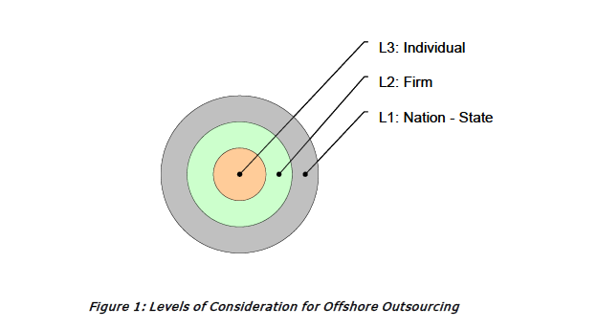
IP ownership - innovation first place market advantage
Notes:
Few things on IoT,
Space Craft
Automobiles
Coffee Machines
Medical Devices
AC

Slide 5
IP ownership - innovation first place market advantage
In recent decades, two international institutions have led the drive toward global Intellectual Property Rights harmonization:
                World Intellectual Property Organization (WIPO), which is an agency of the United Nations
                World Trade Organization (WTO)
The WTO's Agreement on Trade-Related Aspects of Intellectual Property Rights (TRIPS) of 1994 formed the basis for international cooperation on IPR (Correa, 2000).
As a result, IPR, especially copyright and patent, laws must follow a minimum set of guidelines, and indeed most countries do have similar IPR legislation. The real difference at the national level lies in two areas: enforcement and trade secrets.
Correa, C. (2000). Intellectual Property Rights, the WTO and Developing Countries: The TRIPS Agreement and Policy Options. Zed Books Ltd. p. 123-160.
Notes:
Few things on IoT,
Space Craft
Automobiles
Coffee Machines
Medical Devices
AC

Slide 6
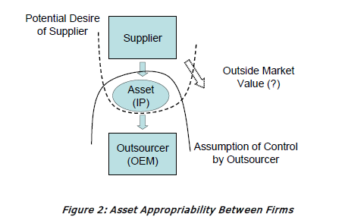
IP ownership - innovation first place market advantage
Notes:
Few things on IoT,
Space Craft
Automobiles
Coffee Machines
Medical Devices
AC

Slide 7

Thank you for your attention

Slide 8


Thank you for your attention
champake.mendis@tripleasuper.com.au, champake@ieee.org
cmendis@csu.edu.au
presetsuper.com.au
tripleasuper.com.au
mendisc.com

